Slide 1
Bulk RNA-seq data cleaning and differential expressed gene analysis
Genomics 5488 | 2025-2-20
Alana & Ben

Slide 2


Welcome (back) to

Slide 3

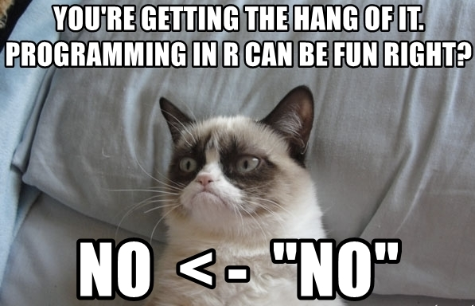


esources
Cheat sheet
Int oduction to the language
One hour crash cou se

Slide 4

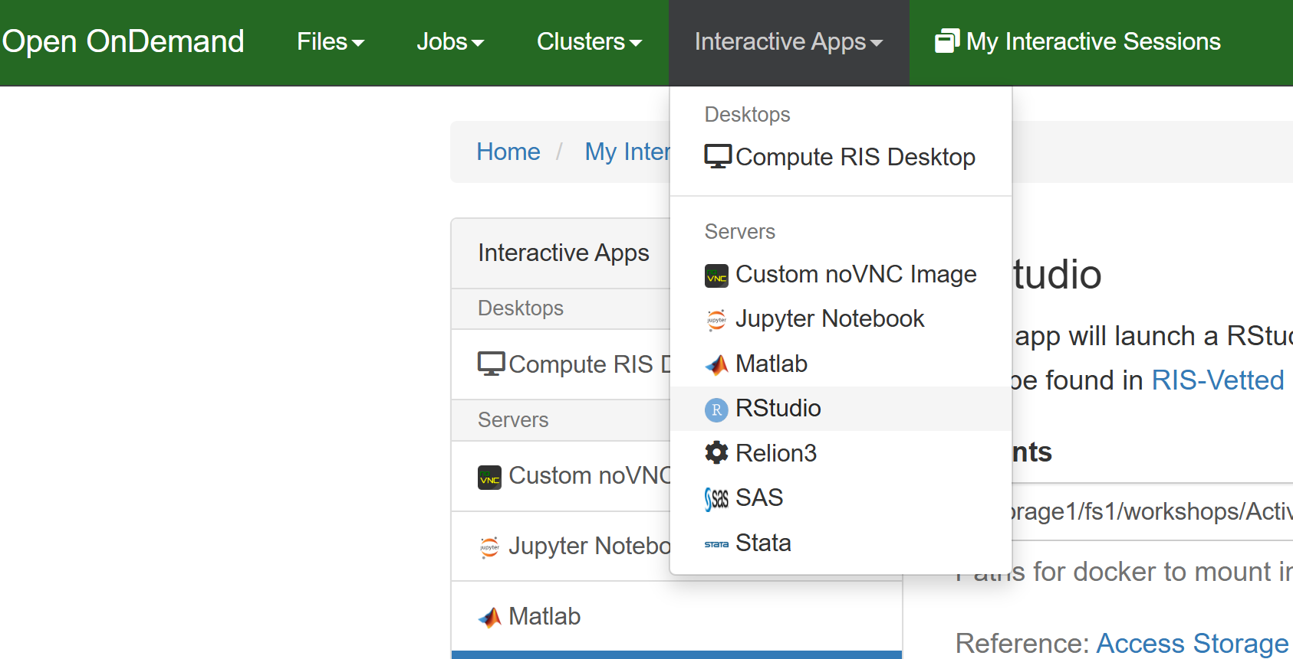

R on the RIS
Login to RIS Open OnDemand
Go to “Interactive Apps” → “Rstudio”
Add appropriate mount directories
Apply resources
Launch

Slide 5
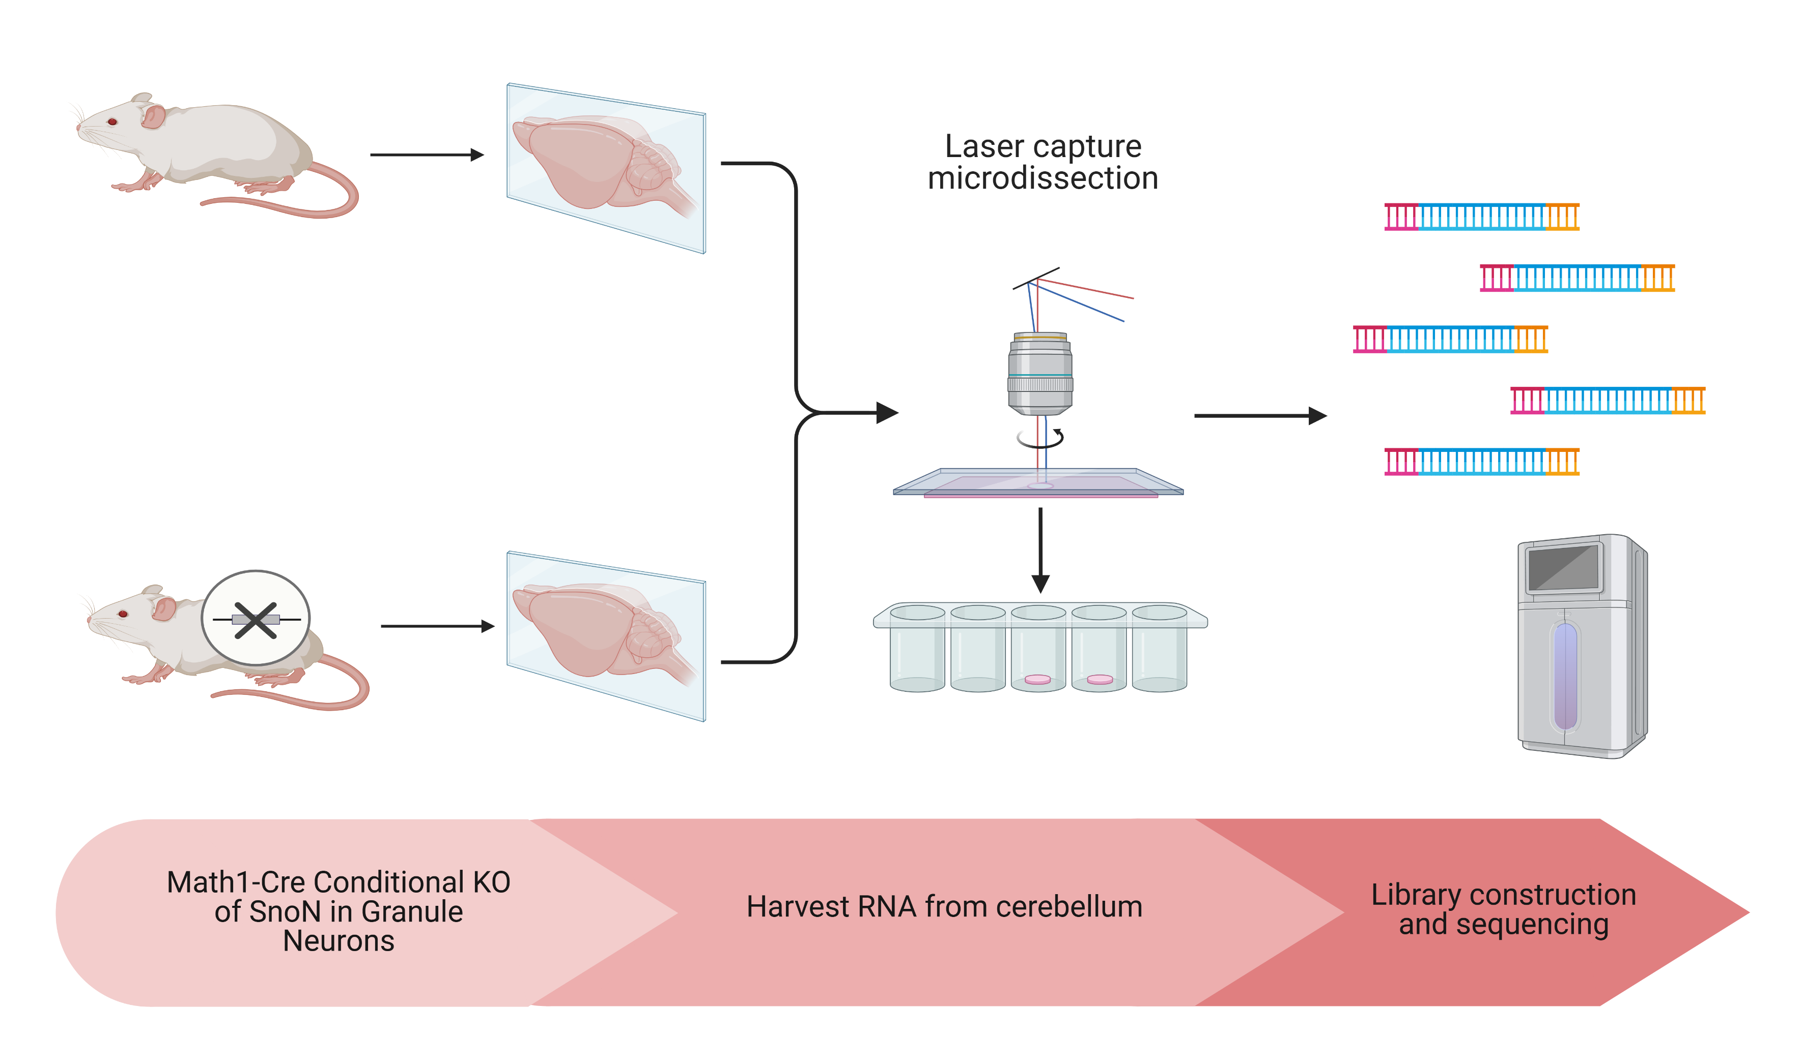
Homework Problem Introduction

Slide 6
Overview of Workflow
Get Files
Gene Expression Counts
Data Pre-Processing
Low Count Samples
Analysis
Model and Contrast Setup
Experiment Design Matrix
Lowly Expressed Genes
Sample Clustering
Replicate Check
Significant Genes Calculation
Visualizations
Pathway Enrichment

Slide 7
Starting Files Check List
Two files are needed before beginning analysis
Experiment Design Matrix – a table annotating the factors (i.e. treatments, genotypes) of each sample.
FeatureCounts matrix – a table of gene expression counts for each gene and sample.

Slide 8
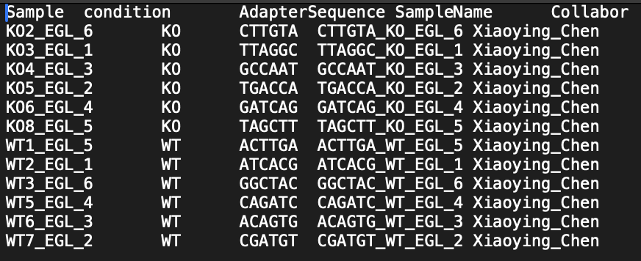
Data Structure – Experiment Design
Experiment Design matrix describes the factors that each sample belongs to.
CSV or TSV file type.
First column contains unique name for each sample, names exactly match those in the Counts table.
Subsequent columns represent factors in the experiment.
Alternative names “Design Matrix”

Slide 9
Data Structure – Counts Table
ColData (Experiment Design)
Counts tables describe the number of observations of each gene for each sample.
Provided by BRB-Seq pipeline.
CSV or TSV
Sample names need to EXACTLY match the experiment design matrix.
Left most column indicates gene ID, subsequent columns contains counts for each sample.
Avoid re-ordering rows. Keep originals. Make copies every time an adjustment is made.
Alternative Names: FeatureCounts, Expression Data, Counts table or matrix, Assay.
 |  |  |  | SampleName | D07_Rot_Rep1 | D07_Rot_Rep2 | D07_Rot_Rep3 | D07_Sham_Rep1 | D07_Sham_Rep2 | D07_Sham_Rep3 | …
 |  |  |  | CellLine | D07 | D07 | D07 | D07 | D07 | D07
 |  |  |  | Drug | Rotenone | Rotenone | Rotenone | Sham | Sham | Sham
ENSEMBL_ID | Symbol | Name |  |  | D07_Rot_Rep1 | D07_Rot_Rep2 | D07_Rot_Rep3 | D07_Sham_Rep1 | D07_Sham_Rep2 | D07_Sham_Rep3 | …
ENSG00000223972 | SIRT4 | sirtuin 4 |  | ENSG00000223972 | 0 | 0 | 0 | 0 | 0 | 0
ENSG00000227232 | HMGB3P7 | NA |  | ENSG00000227232 | 94 | 56 | 130 | 55 | 9 | 74
ENSG00000243485 | TNFRSF10B | TNF receptor superfamily member 10b |  | ENSG00000243485 | 0 | 0 | 0 | 0 | 0 | 0
ENSG00000237613 | LEP | leptin |  | ENSG00000237613 | 0 | 0 | 0 | 0 | 0 | 0
ENSG00000268020 | CTBP2P1 | NA |  | ENSG00000268020 | 0 | 0 | 0 | 0 | 0 | 0
ENSG00000240361 | TNFRSF10B | TNF receptor superfamily member 10b |  | ENSG00000240361 | 0 | 0 | 0 | 0 | 0 | 0
ENSG00000186092 | OR10AB1P | NA |  | ENSG00000186092 | 0 | 0 | 0 | 0 | 0 | 0
… |  |  |  | …
Assay (Counts)

Slide 10
Data Structure – Gene Annotation
ColData (Experiment Design)
Gene annotation tables convert a unique identifier for genes to common names or gene symbols.
Converts unique gene IDs to gene symbol/function
 |  |  |  | SampleName | D07_Rot_Rep1 | D07_Rot_Rep2 | D07_Rot_Rep3 | D07_Sham_Rep1 | D07_Sham_Rep2 | D07_Sham_Rep3 | …
 |  |  |  | CellLine | D07 | D07 | D07 | D07 | D07 | D07
 |  |  |  | Drug | Rotenone | Rotenone | Rotenone | Sham | Sham | Sham
ENSEMBL_ID | Symbol | Name |  |  | D07_Rot_Rep1 | D07_Rot_Rep2 | D07_Rot_Rep3 | D07_Sham_Rep1 | D07_Sham_Rep2 | D07_Sham_Rep3 | …
ENSG00000223972 | SIRT4 | sirtuin 4 |  | ENSG00000223972 | 0 | 0 | 0 | 0 | 0 | 0
ENSG00000227232 | HMGB3P7 | NA |  | ENSG00000227232 | 94 | 56 | 130 | 55 | 9 | 74
ENSG00000243485 | TNFRSF10B | TNF receptor superfamily member 10b |  | ENSG00000243485 | 0 | 0 | 0 | 0 | 0 | 0
ENSG00000237613 | LEP | leptin |  | ENSG00000237613 | 0 | 0 | 0 | 0 | 0 | 0
ENSG00000268020 | CTBP2P1 | NA |  | ENSG00000268020 | 0 | 0 | 0 | 0 | 0 | 0
ENSG00000240361 | TNFRSF10B | TNF receptor superfamily member 10b |  | ENSG00000240361 | 0 | 0 | 0 | 0 | 0 | 0
ENSG00000186092 | OR10AB1P | NA |  | ENSG00000186092 | 0 | 0 | 0 | 0 | 0 | 0
… |  |  |  | …
RowData (Gene Annotation)
Assay (Counts)

Slide 11
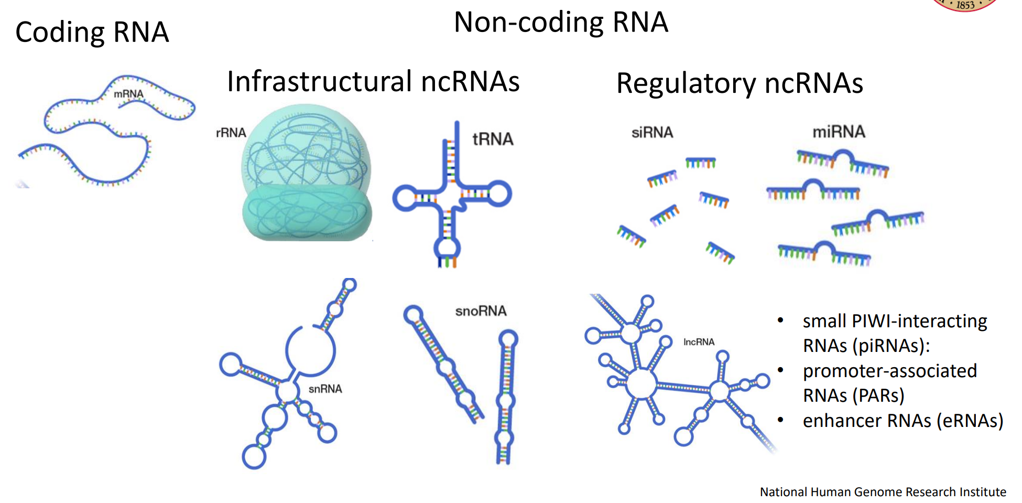
Gene Filtering
What kind of RNA species are you interested in?

Slide 12
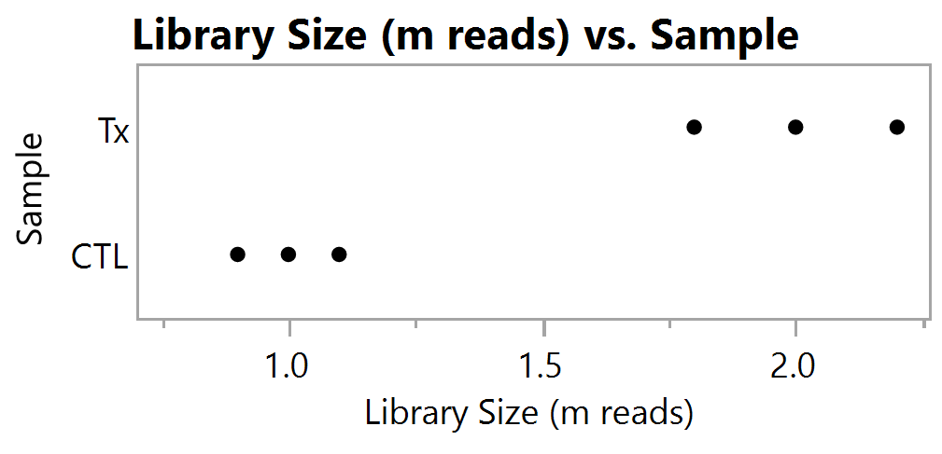
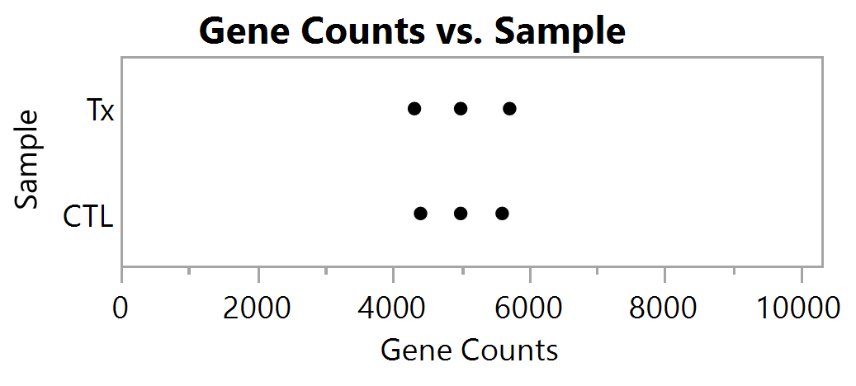
Count Normalization

Slide 13
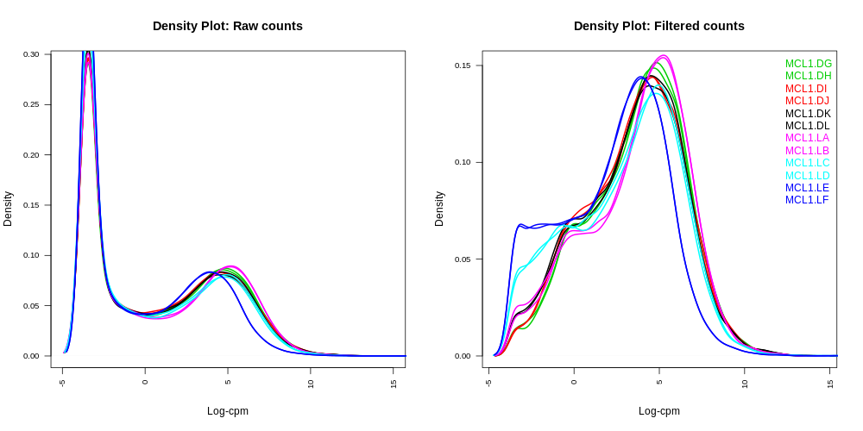
Low Count Filtering

Slide 14
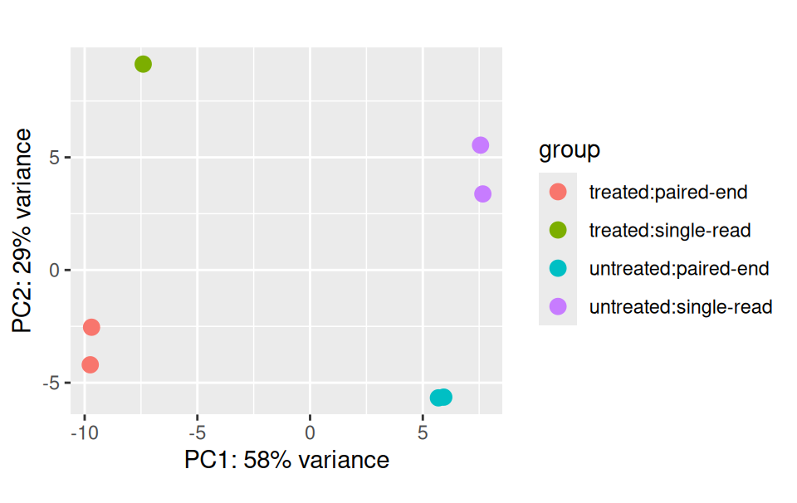
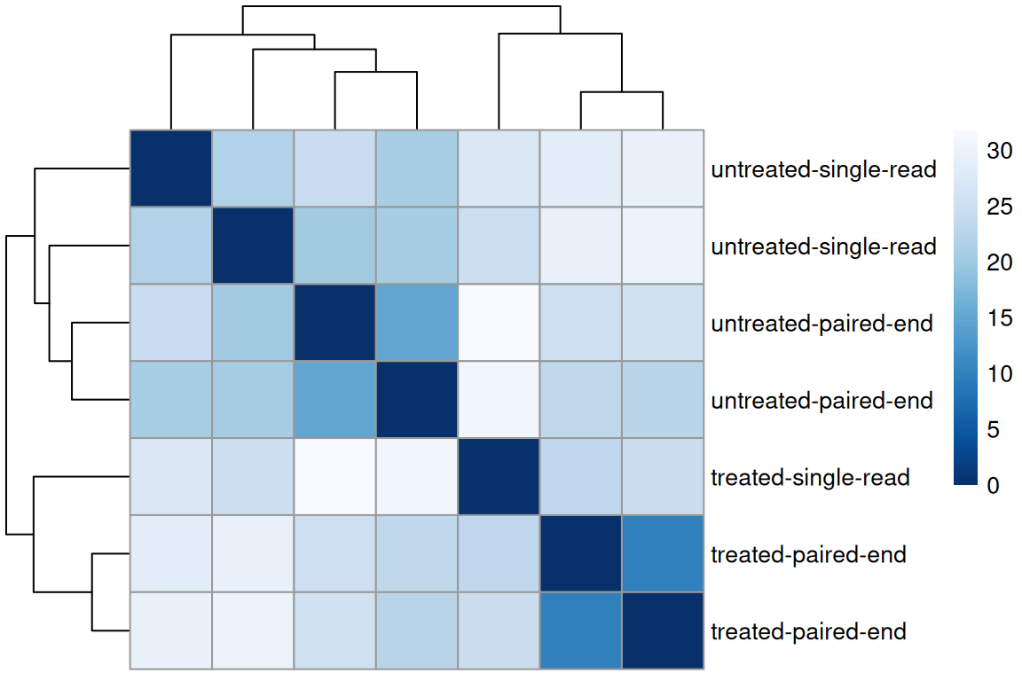
Sample Clustering

Slide 15
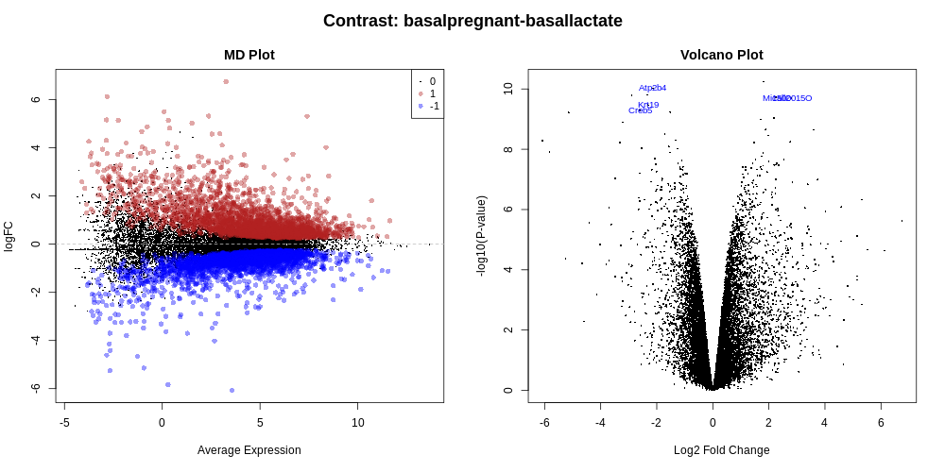
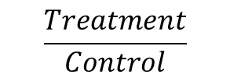
Differential Analysis
$$\frac{Treatment}{Control}$$
“leveling”

Slide 16
Conclusions
Setup programming environment
Prepare sample data
Filter and normalize sample data
Quality control
Differential analysis
Plan next steps

Slide 17
Submission: (deadline: 2/27/2026, 11:59PM): 1. Submission path: /storage1/fs1/workshops/Active/BIO5488/SP2026.L41.BIOL.5488.01/Assignments/A06/Submissions/Users/<Username> 2. Rmd file 3. html output from Rmd 4. pngs required by each questions. Note: for all plots, please print them in the rmd/html file as well.

Slide 18
